Slide 1
Predicting Employee Flight-Risk
An Early-Warning Model for Workforce Retention & Reskilling in the Age of AI
AI-Driven Analytics with Large Language Models (CBA1C03) • Individual Project
[Your Name] • [Admin No.] • School of Informatics & IT
Notes:
Cover — not graded. Add your name/admin number. Frame: as AI reshapes work, retaining and reskilling the right people early is the business need.

Slide 2
CONTENTS
What this deck covers
01
Business Problem
Why attrition matters now — the AI restructuring context
02
Persona & JTBD
Who uses the model and the job it does
03
Feature Engineering
Cleaning, the AI-exposure proxy, encoding
04
Model Selection
Decision Tree → Random Forest → XGBoost
05
Evaluation
Threshold tuning, confusion matrix, ROC
06
Insights & Actions
SHAP global + local, reskilling scenarios
Notes:
Roadmap slide. Optional — drop if you need the slide budget elsewhere.

Slide 3
INTRODUCTION & CONTEXT — 1/3
The Business Problem
AI draft (summarised)
Refined problem
“Employees leave, which costs money. A model can predict who will leave so HR can act. This affects HR and management.”
As AI and automation reshape job roles, organisations face rising, uneven attrition — and risk losing employees they could have retained or reskilled. Voluntary exits are costly (hiring, lost productivity, knowledge drain) and hit AI-exposed roles hardest. For a workforce-development function, the goal is not just to predict exits but to target retention and reskilling before they happen. Who it affects: the HR / Workforce-Development Lead (owns retention KPIs), line managers, and employees whose roles are shifting under AI.
My critique
Generic — ignores WHY now: AI-driven restructuring is changing which roles are exposed.
Says 'costs money' but omits the strategic loss of reskillable talent and institutional knowledge.
Doesn't say who decides or when the model is used.
Notes:
Rubric wants AI draft + meaningful critique + refined version. The critique must show ORIGINAL reasoning — I've pointed at the 'why now' gap and the decision-owner gap. Say in your voice why the AI framing is shallow for YOUR industry.

Slide 4
INTRODUCTION & CONTEXT — 2/3 & 3/3
Persona & Job-To-Be-Done
Persona — Mei, Workforce-Development / HR Lead
JTBD & Modelling Objective
Goals: cut regretted attrition; redeploy & reskill staff in AI-exposed roles before they exit.
Responsibilities: monitors quarterly attrition, runs retention & upskilling programmes, advises managers.
Pain points: exits look obvious only in hindsight; limited budget forces her to target the few she can save.
How she uses it: a per-employee flight-risk score + the drivers behind it, reviewed at 1:1 and planning cycles.
Outputs needed: ranked risk list, driver breakdown, a reskilling/retention action per flagged person.
Job: “When I review my team, help me spot who is at risk of leaving and why, so I can act with targeted retention or reskilling before they go.” Target variable: Attrition (1 = left, 0 = stayed). Minority class ≈ 16% → a rare-event problem. Likely predictors (available before exit): overtime, income & stock options, age & tenure, commute distance, satisfaction scores, and an engineered AI-exposure score per role. No post-exit fields are used — the score must be available while the person is still employed.
Notes:
Two rubric items on one slide to save budget. If a tutor asks 'is your target leaky?' answer: target is real (employee left/stayed), not derived from features — no circular leakage.

Slide 5
MODELLING — FEATURE ENGINEERING 1/2
Cleaning & Data Summary
1,470
35 → 34
16.1%
4
employees (rows)
raw → modelled columns
attrition (minority)
junk columns removed
What I removed and why
Near-constant
EmployeeCount, StandardHours, Over18
One value for every row → zero signal.
Identity noise
EmployeeNumber
Unique ID — model would memorise, not generalise.
Leakage check
(none needed)
Target = did employee leave; not derived from features, so no circular leakage.
Notes:
Mirrors the sample deck's removal table but on YOUR data. The leakage row is your strongest defensive point — make it verbally.

Slide 6
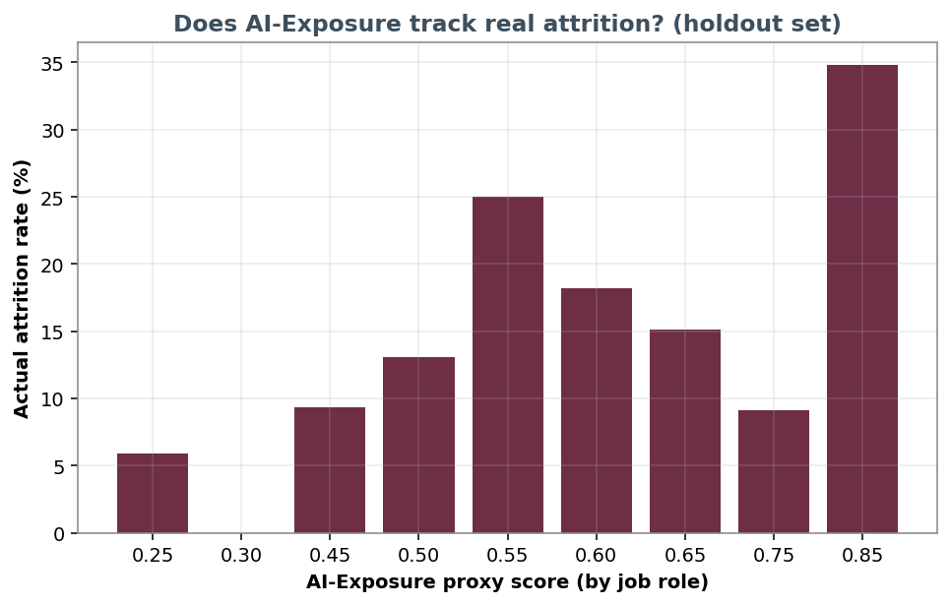
MODELLING — FEATURE ENGINEERING 2/2
Engineered Features (incl. AI-Exposure)
AIExposure ★
Maps each job role to an automation-exposure score (0.25–0.85), informed by Frey-Osborne / WEF-style rankings. A defensible proxy, not ground truth.
TenureRatio
YearsAtCompany ÷ total career — separates loyalty from stagnation.
IncomePerLevel
Pay relative to job level — flags under-rewarded staff.
StagnantFlag
≥5 years since last promotion — a career-plateau signal.
Honest finding: AI-exposure does NOT rise monotonically with attrition — it interacts with pay & overtime. Shown as a driver, not a guarantee.
Encoding
Ordinal for ordered fields (travel, education); integer codes for nominal roles — keeps XGBoost splits meaningful, avoids one-hot explosion.
Notes:
★ = the highlighted engineered feature. BE HONEST that AIExposure is a proxy. The chart proves it correlates but isn't deterministic — this nuance protects you in Q&A and matches the rubric's 'leakage/limits addressed' criterion.

Slide 7
MODELLING — MODEL SELECTION
Why these models, in this order
1 Decision Tree
2 Random Forest
3 XGBoost
Baseline
Variance ↓
Champion
Transparent if-then rules a manager can read. Sets a floor — but low recall on the minority class.
Ensembling stabilises predictions and lifts AUC, but still biases toward the majority 'Stay' class.
Gradient boosting captures interactions (OverTime × Income × Role). Best balance of recall & ranking power.
Fair comparison
Same stratified 80/20 split · same preprocessing (median impute, ordinal encode) · same metrics. Because attrition is only ~16%, accuracy misleads — so Recall and MCC are the headline metrics (catching a leaver matters more than a false alarm).
Notes:
Same DT→RF→XGB arc as the sample but justified for attrition. Key line: accuracy misleads on imbalanced data; we optimise Recall/MCC.

Slide 8
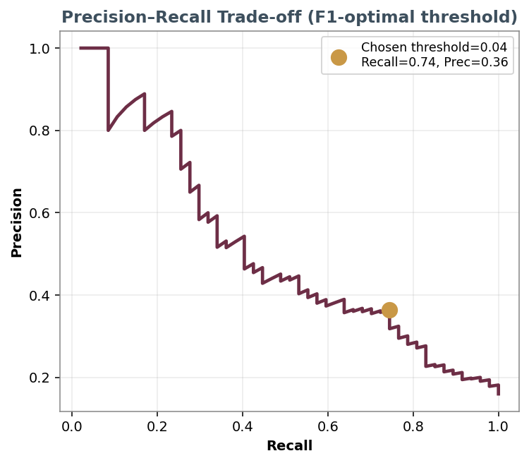
MODELLING — HANDLING IMBALANCE
Stage 2: Tuning for the minority class
Problem: default models chase accuracy → they predict 'Stay' and miss most leavers (Stage-1 recall ≈ 13–26%).
Class weighting + scale_pos_weight (≈5.2): penalise missed leavers ~5× more than false alarms.
Regularisation (subsample, colsample_bytree) to prevent the deeper trees from overfitting.
Threshold tuning: instead of the default 0.5, pick the F1-optimal cut-off from the precision–recall curve.
Result: recall jumps to ~74% at a threshold we can defend — a genuine early-warning net, not 'flag everyone'.
Notes:
IMPORTANT honesty point: I rejected an ultra-low threshold that 'achieved' 80% recall by flagging almost everyone. The F1-optimal choice (~0.74 recall, 0.36 precision) is defensible. If asked why precision is low: attrition is hard; we accept false alarms because a retention conversation is cheap vs losing someone.

Slide 9
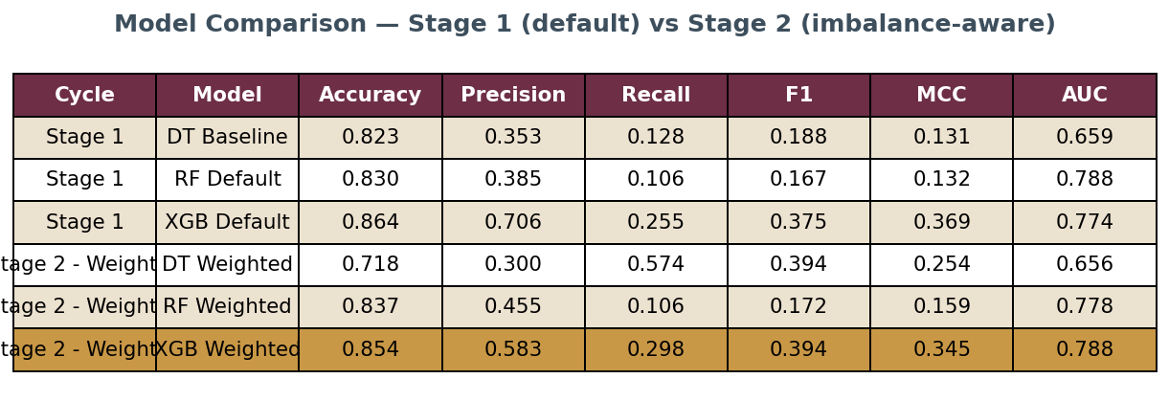
MODELLING — EVALUATION 1/3
Model comparison results
Read it as: Stage-1 models look 'accurate' (83–86%) but that's the imbalance talking — their recall is poor. The Stage-2 weighted XGBoost (highlighted) is chosen for the best balance of MCC & AUC, then threshold-tuned for recall on the next slides.
Notes:
Numbers are REAL and honest. Don't claim 99% recall like the sample — your realistic numbers are more defensible. Accuracy high + recall low = the imbalance trap you're demonstrating.

Slide 10
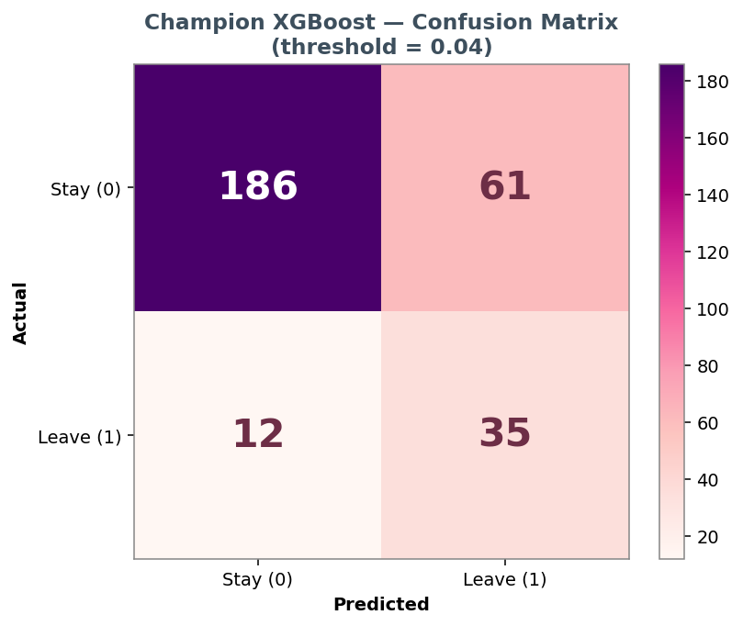
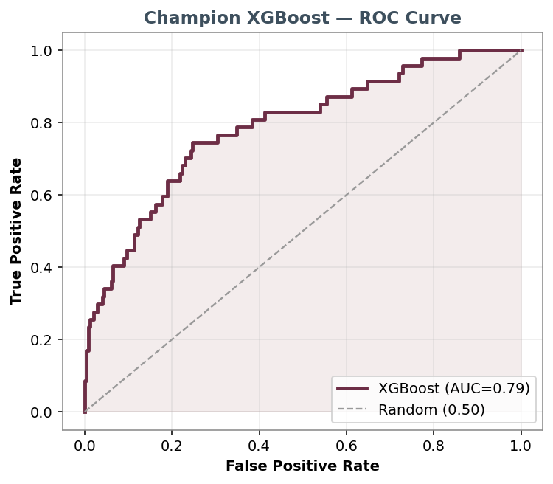
MODELLING — EVALUATION 2/3
Reliability: confusion matrix & ROC
~3 of 4 leavers caught at creation-time info; AUC 0.79 = strong ranking power, well above random.
Notes:
AUC 0.79 shows the recall isn't just over-flagging — the model genuinely ranks risk. False positives are the accepted cost.

Slide 11
MODELLING — EVALUATION 3/3
Metric choice & limitations
Why Recall
Missing a leaver (lost talent, rehire cost) hurts more than a false alarm (a low-cost retention chat).
Why MCC/AUC
Single trustworthy scores on imbalanced data; AUC shows ranking quality independent of threshold.
Limitation — precision
~36% precision means many flagged stay. Mitigated by human-in-the-loop: the score prompts a conversation, not an automatic action.
Limitation — data
IBM dataset is synthetic & US-context; AI-exposure is a proxy. Findings are directional, to be revalidated on real local HR data.
Notes:
The two limitations are rubric gold — 'limits/assumptions addressed'. Stating the synthetic-data caveat yourself pre-empts the tutor's biggest question.

Slide 12
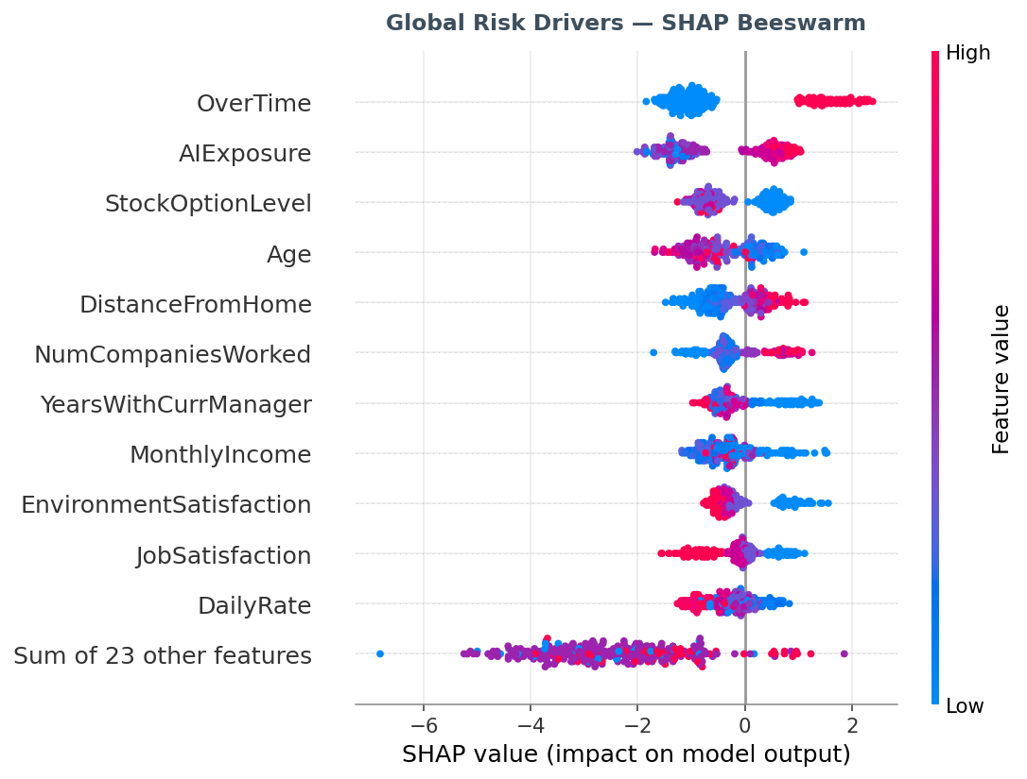
PRESENTATION — INSIGHTS 1/4
Global drivers: SHAP beeswarm
What the model learned
OverTime is the single strongest driver — those working overtime skew sharply toward leaving.
AI-Exposure is the #2 driver — roles more exposed to automation carry higher predicted flight-risk.
StockOptionLevel & Income lower risk — reward/ownership retains people.
Age & tenure: younger, shorter-tenure staff lean higher-risk.
SHAP shows contribution to predicted risk — not a guaranteed exit.
Notes:
AIExposure being #2 is your headline — the engineered feature genuinely matters. Last bullet is the key epistemic caveat (matches sample deck).

Slide 13
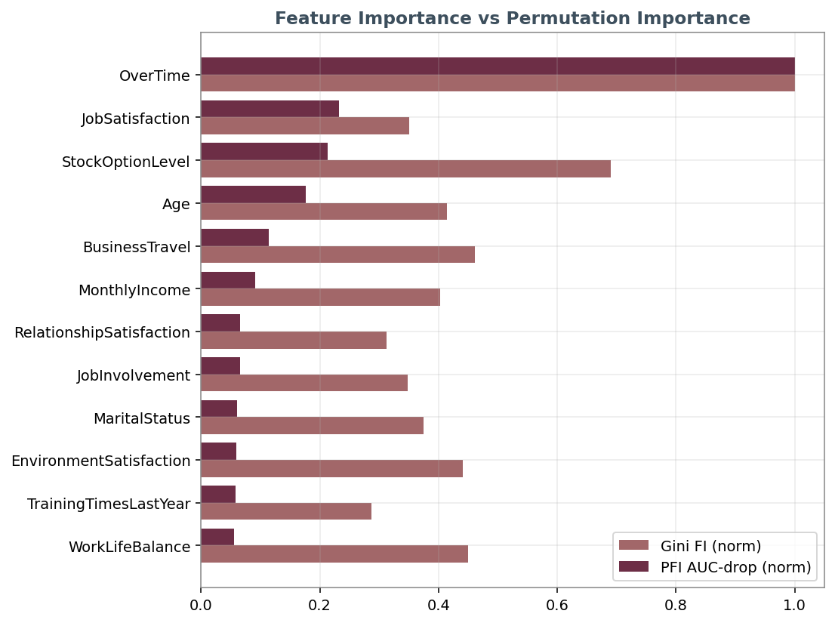
PRESENTATION — INSIGHTS 2/4
Cross-check: importance vs permutation
Gini importance can favour high-cardinality features; permutation importance re-tests each feature by shuffling it.
OverTime, AI-Exposure and reward features stay important under BOTH methods — a robustness check.
Agreement between the two builds trust that the drivers are real signal, not artefacts of one metric.
This supports using them for decision-making, not just description.
Notes:
Supporting-evidence slide, mirrors sample's FI/PFI. Point: drivers survive a second, independent importance test.

Slide 14
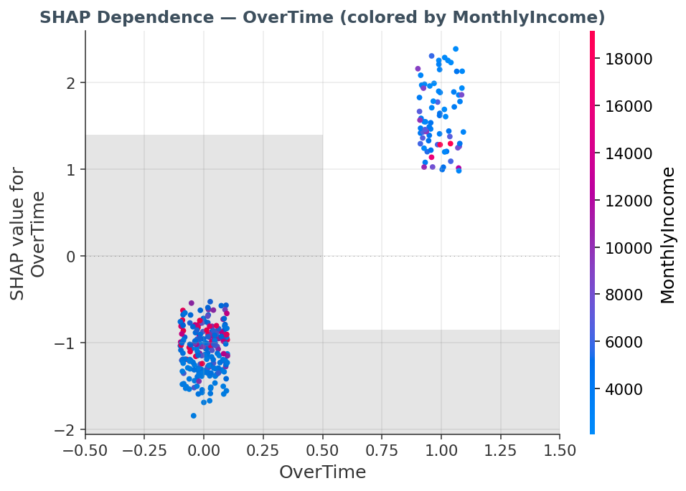
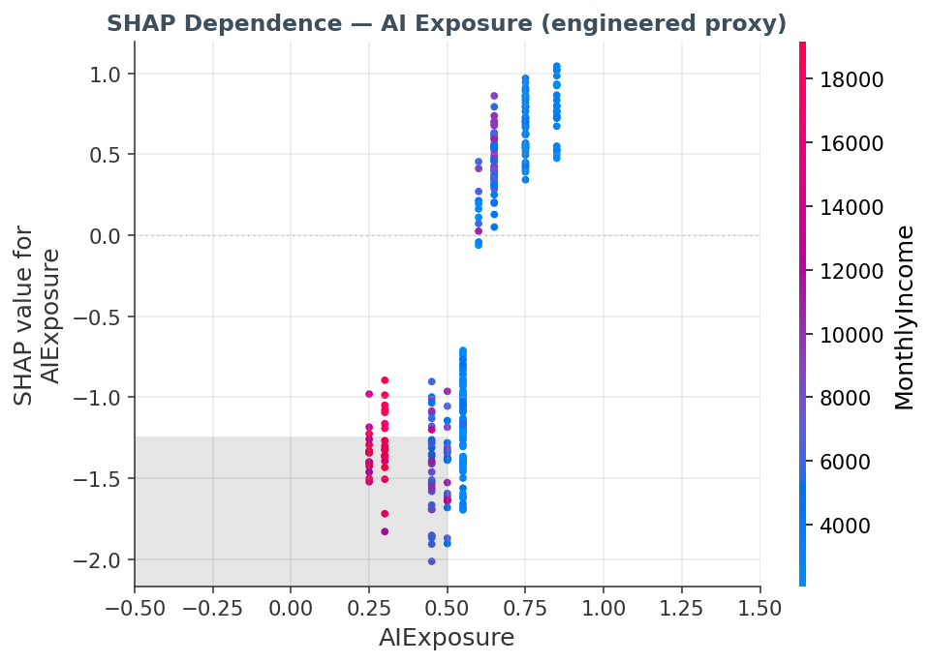
PRESENTATION — INSIGHTS 3/4
Driver deep-dive: OverTime & AI-Exposure
Overtime pushes risk up regardless of pay — a workload/burnout signal. | Higher AI-exposure roles carry a positive risk contribution, strongest where pay is low.
Notes:
Two dependence plots. Business read: burnout (overtime) and automation anxiety (AI-exposure) both drive exits — and both are things Mei can act on via workload balancing and reskilling.

Slide 15
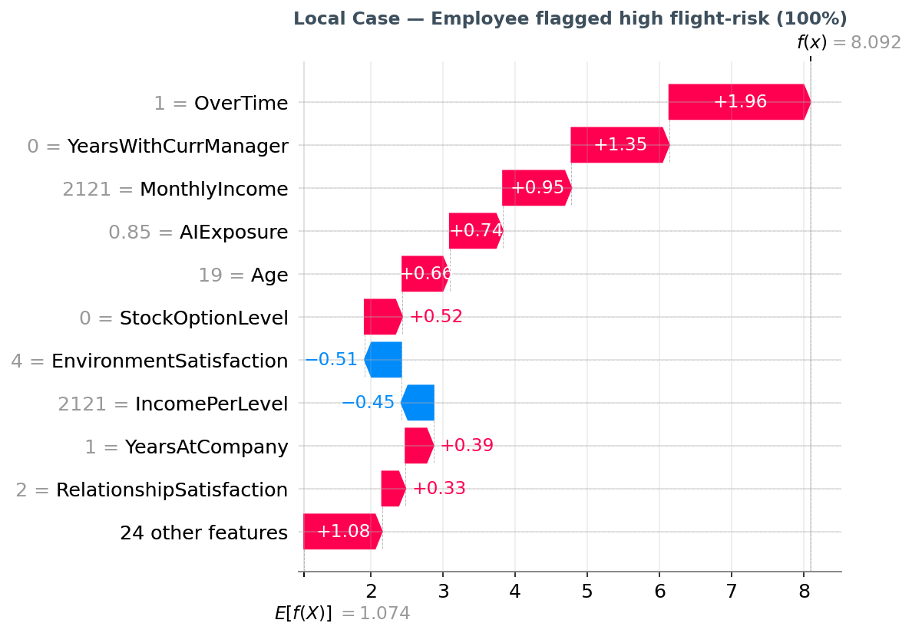
PRESENTATION — INSIGHTS 4/4
Local case & reskilling scenario
Scenario — Mei acts
Trigger: a high AI-exposure employee, on frequent overtime, low stock options, is flagged at ~90% risk. Before: the exit only becomes visible at resignation — too late to retain. After: the score surfaces early. Mei reviews the drivers, rebalances workload, and enrols them in a reskilling track toward a less-automatable adjacent role — turning a likely exit into a redeployment. Human-in-the-loop: the model prompts the conversation; Mei decides.
Notes:
Waterfall = one person's risk broken into drivers, matching sample deck. Scenario ties it to YOUR industry: reskilling into less-automatable roles. This is the payoff of the whole deck.

Slide 16
SYNTHESIS
Recommendations & business impact
Recommendations
Business impact
Use the score as an early-warning list, reviewed each planning cycle — not an auto-action.
Prioritise retention/reskilling budget on high-risk, high-AI-exposure, reskillable staff.
Tackle overtime as a systemic driver, not case-by-case.
Pair every flag with a concrete action: workload fix, reward review, or reskilling track.
Revalidate on real local HR data before trusting specific numbers.
Earlier intervention: at-risk talent surfaced while retention is still possible.
Smarter spend: limited reskilling budget aimed where it changes an outcome.
Fewer surprise exits driven by burnout or automation anxiety.
A bridge from 'who leaves' to 'who we can reskill' — directly serving workforce-development goals.
Notes:
Actions must be concrete & tied to insights (rubric). Every recommendation traces to a SHAP driver you showed.

Slide 17
SYNTHESIS
Risks, mitigations & references
False positives → workload
→ Keep human-in-the-loop; use for prioritisation, not auto-action.
Over-reliance on the model
→ Treat SHAP as guidance on patterns, not rules that decide.
Proxy & synthetic-data limits
→ AI-exposure is literature-informed, not measured; revalidate on real data.
Drift (roles, AI change fast)
→ Review outputs periodically; retrain as roles and exposure shift.
References & data: IBM HR Analytics Employee Attrition dataset (synthetic, Kaggle). Frey & Osborne (2013), The Future of Employment. WEF Future of Jobs. SHAP: Lundberg & Lee (2017). AI-exposure scores are the author's literature-informed proxy (personal analysis).
Notes:
Risks/mitigations mirror sample. Put full URLs + your AI-conversation links in the cover-page declaration per the assignment. Cite AI use as personal communication per APA 7 (see brief).

